Slide 1
Presenting and Aggregating Results

Slide 2

Overview
Sorting query results
Applying aggregate calculations

Slide 3
Querying Residency
SELECT name, state
FROM residency;
name | state
Amy | Oregon
Justin | Wyoming
Sheila | Texas
Jim | Texas
Marsha | Oregon
Richard | Arizona

Slide 4

SELECT name,
state
FROM residency ORDER BY name
Residency table
name | state
Amy | Oregon
Justin | Wyoming
Sheila | Texas
Jim | Texas
Marsha | Oregon
Richard | Arizona
name | state
Amy | Oregon
Jim | Texas
Justin | Wyoming
Marsha | Oregon
Richard | Arizona
Sheila | Texas

Slide 5
Specifying Sort Order
A
Z
A
Z
1
100
1
100
Ascending Smallest to largest
Descending Largest to smallest
SORT BY ASC
SORT BY DESC

Slide 6
SELECT name,
state
FROM residency ORDER BY state, name
Residency table
name | state
Amy | Oregon
Justin | Wyoming
Sheila | Texas
Jim | Texas
Marsha | Oregon
Richard | Arizona
name | state
Richard | Arizona
Amy | Oregon
Marsha | Oregon
Jim | Texas
Sheila | Texas
Justin | Wyoming

Slide 7
SELECT name,
state
Residency table
FROM residency
ORDER BY state DESC, name ASC
name | state
Amy | Oregon
Justin | Wyoming
Sheila | Texas
Jim | Texas
Marsha | Oregon
Richard | Arizona
Name
state
Justin
Wyoming
Jim
Texas
Sheila
Texas
Amy
Oregon
Marsha
Oregon
Richard
Arizona

Slide 8
SELECT name,
state
Residency table
FROM residency
ORDER BY 2 DESC, 1 ASC
name | state
Amy | Oregon
Justin | Wyoming
Sheila | Texas
Jim | Texas
Marsha | Oregon
Richard | Arizona
Name | state
Justin | Wyoming
Jim | Texas
Sheila | Texas
Amy | Oregon
Marsha | Oregon
Richard | Arizona

Slide 9
Aggregate Functions
COUNT
SUM
AVG
MIN
MAX

Slide 10
SELECT AVG(age)
name | grade_lvl | age
Eliza | Junior | 17
Jane | Junior | 17
Leslie | Senior | 19
Matt | Junior | 16
Ned | Freshman | 15
Susie | Junior | 18
AS avg_age
FROM person;
Aggregate Functions
To use an aggregate function, include it in the SELECT clause
The above code returns an average age of 17

Slide 11



Analyzing Groups
Aggregate functions can be used for more sophisticated analysis
What is our average age by grade level?
GROUP BY keyword is used to specify groups

Slide 12
SELECT grade_lvl,
AVG(age) AS avg_age FROM person
GROUP BY grade_lvl;
◀ Aggregate average function
◀ Group results by grade level
name | grade_lvl | age
Eliza | Junior | 17
Jane | Junior | 17
Leslie | Senior | 19
Matt | Junior | 16
Ned | Freshman | 15
Susie | Junior | 18
grade_lvl | avg_age
Freshman | 15
Junior | 17
Senior | 19

Slide 13
Using GROUP BY With Aggregation
Incorrect
Correct
SELECT grade_lvl,
MIN(age) AS minimum_age FROM person;
SELECT grade_lvl,
MIN(age) AS minimum_age FROM person
GROUP BY grade_lvl;
All non-aggregate fields in the SELECT clause must be represented in the GROUP BY clause

Slide 14
Demo
Explore aggregate functions

Slide 15
Filtering Aggregate Results
WHERE
HAVING
Filter single rows
Filter aggregate results

Slide 16
SELECT grade_lvl,
AVG(age) AS avg_age FROM person
GROUP BY grade_lvl
HAVING AVG(age) < 19;
◀ HAVING clause specifies that we
want to filter aggregate values from AVG
name | grade_lvl | age
Eliza | Junior | 17
Jane | Junior | 17
Leslie | Senior | 19
Matt | Junior | 16
Ned | Freshman | 15
Susie | Junior | 18
grade_lvl | avg_age
Freshman | 15
Junior | 17

Slide 17
Demo
Using HAVING to filter results

Slide 18
Understanding Subqueries in PostgreSQL
A subquery is a query nested inside another query
Types of Subqueries
Single-row
Multiple-row
Correlated
Used to perform operations that require intermediate results.
Modularity: Break complex queries into simpler parts.
Readability: Makes queries easier to understand.
Flexibility: Can be used in SELECT, INSERT, UPDATE, DELETE statements.
Execution Time: Subqueries can be slower than joins in some cases.
Optimization: PostgreSQL may optimize subqueries for better performance.

Slide 19
Database Views in PostgreSQL
Views are created using the CREATE VIEW statement.
A view in PostgreSQL is a virtual table that represents the result of a database query. It can simplify complex queries, enhance security, and provide a consistent interface to data.
Use views to create a customized presentation of data from one or more tables.
Scenarios for Using Views:
Simplifying Complex Queries Enhancing Security Providing a Layer of Abstraction Aggregated Data Join Operations
CREATE VIEW view_name AS
SELECT column1, column2, ...
FROM table_name
WHERE condition;
DROP VIEW IF EXISTS flight_info;

Slide 20
Writing High-Performing SQL Queries
Technique
Purpose
Use Indexes Wisely
Speed up data retrieval.
Reduce I/O overhead.
**Avoid SELECT ***
Optimize query performance.
Use JOINS Efficiently
Improve performance by reducing the amount of data processed.
Limit the Number of Rows Returned
Use Appropriate Data Types
Ensure efficient storage and quick access.
Write Simple and Understandable Queries
Easier to maintain and optimize..

Slide 21
Writing High-Performing SQL Queries
Technique
Purpose
Use EXISTS Instead of IN for Subqueries
Improve performance with large datasets.
Optimize Join Order in Complex Queries
Reduce the amount of data processed in joins.
Use Query Analyzer Tools
Identify and optimize slow queries.
Avoid Using Functions on Indexed Columns in WHERE Clause
Maintain index efficiency.

Slide 22
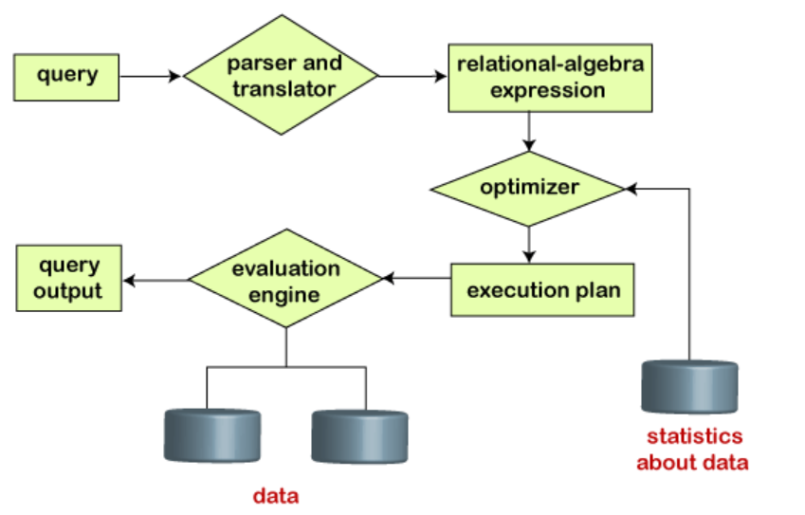
Query Plan Overview

Slide 23
Components of a Query Plan
Seq Scan (Sequential Scan)
Scans the entire table row-by-row. Suitable for small tables or when no relevant indexes exist.
Index Scan
Uses an index to quickly locate rows. Efficient for selective queries where an index exists.
Nested Loop Join
Identify Iterates over rows from one table and for each row, executes a nested query on the second table.
Hash Join
Builds a hash table from the smaller table and probes the hash table using rows from the larger table.

Slide 24
Components of a Query Plan
Merge Join
Joins two sorted datasets by merging them. Efficient for large sorted datasets.
Aggregate
Computes summary statistics like SUM, AVG, COUNT.
Sort
Orders the result set based on specified columns.
Filter
Applies conditions to filter rows.
Limit
Restricts the number of rows returned.

Slide 25
Identifying Performance Issues in SQL Queries
EXPLAIN Command
Use the EXPLAIN command to display the query plan.
EXPLAIN ANALYZE
Provides actual execution statistics along with the query plan. Useful for identifying performance bottlenecks.

Slide 26
Common Performance Issues
Full Table Scans
When the database scans the entire table because no appropriate index is available.
High Cost Operations
Steps in the query plan with high cost values indicate potential bottlenecks.
Join Order
Inefficient join order can cause excessive data processing.
Missing Indexes
Lack of indexes on columns used in WHERE, JOIN, and ORDER BY clauses.
Unoptimized Subqueries
Correlated subqueries can be inefficient if not optimized properly.

Slide 27
Summary
ORDER BY sorts query results
Aggregate functions perform calculations
On entire data set
On groups specified using GROUP BY
HAVING filters aggregate results

